Slide 1
ATN Applications: Montgomery County, Maryland Transit Opportunities
Advanced Transit Association Annual Technical Meeting
January 11, 2014
College Park, Maryland
Robert Johnson
R. E. Johnson Consulting Rockville, Maryland www.REJConsult.com

Slide 2
Basic Assumptions
Proven technology that can be deployed immediately
25 mph (40 kph) maximum speed
Small networks
Shared vehicles, especially during peak periods, to increase capacity
All seated -- allows higher acceleration and jerk levels, which means shorter guideway ramps
4-passenger vehicles – a small vehicle allows a narrow, low-cost guideway

Slide 3
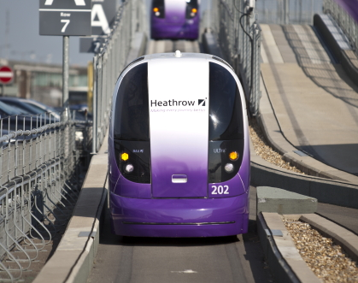
Example of Narrow ATN Guideway

Slide 4
Montgomery County, Maryland
998,000 population
$94,000 median household income
Immediately Northwest of Washington, DC
21% population growth expected by 2040
39% employment growth expected by 2040
Served by Red Line of Washington Metrorail
Peak hour flows to/from I-270 corridor

Slide 5
Planned Montgomery County Bus Rapid Transit System
Corridor Cities Transitway, Lines 1-10
102 miles, 79% dedicated lanes
2011 Parsons Brinckerhoff study recommended guided buses in some corridors
Selected peak link volumes:
Line 7 (Randolph Rd) western section: 900 pphpd
Line 9 (US 29): 1475 pphpd
Issue: Finding right-of-way for dedicated bus lanes

Slide 6
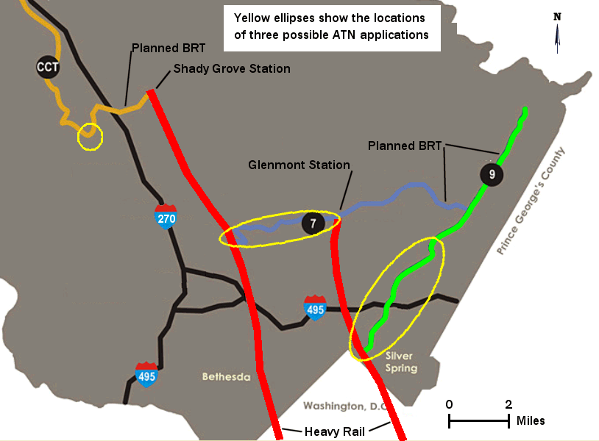

Slide 7
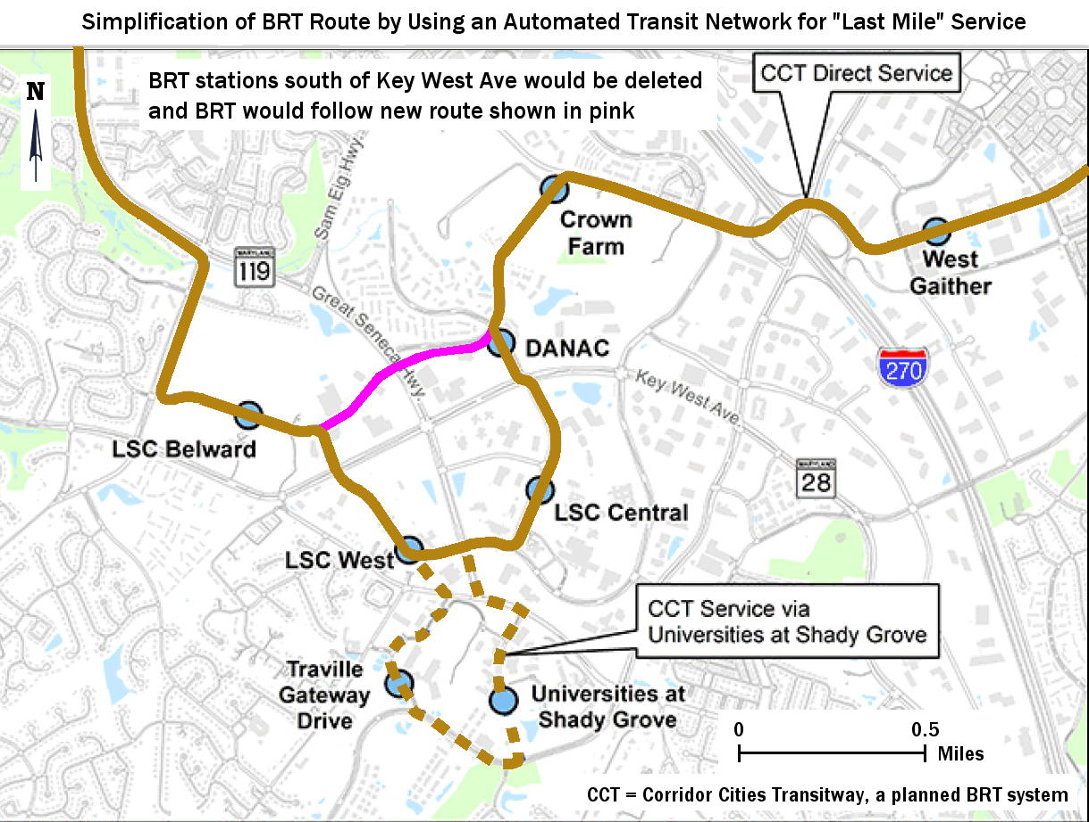

Slide 8
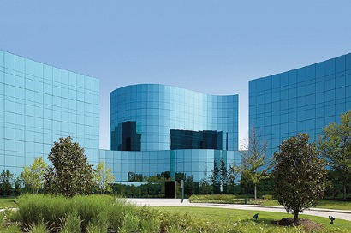
Human Genome Sciences Buildings at the Shady Grove Life Sciences Center

Slide 9
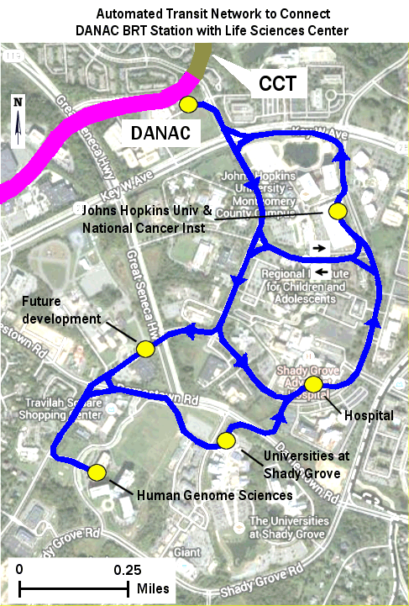

Slide 10
CCT ATN System Benefits
Improve access for many (but not all) Life Sciences Center trips
Avoid two-way bus crossing of major arterial at two locations
Shorter trip times for CCT riders who bypass LSC
Allow uniform CCT headways
LSC internal circulation

Slide 12
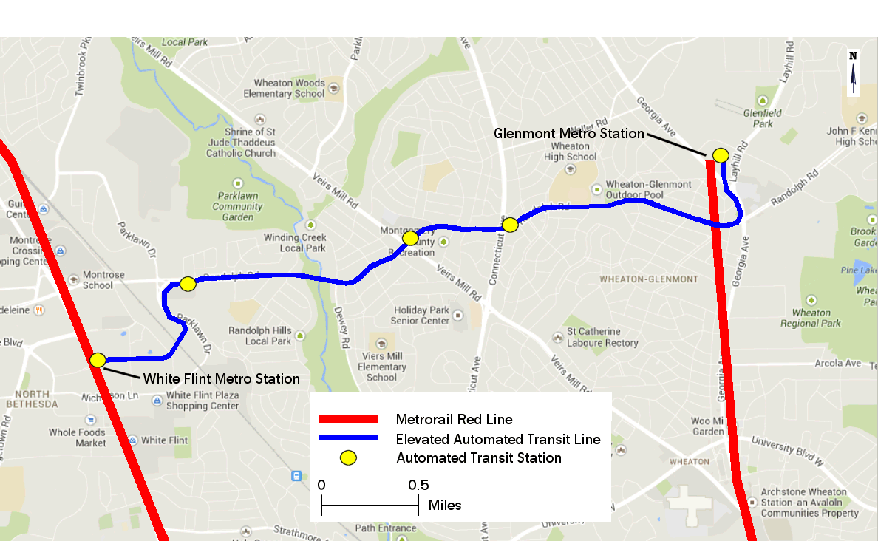
Automated Transit Line to Replace BRT Line 7 Between Branches of the Red Line

Slide 13
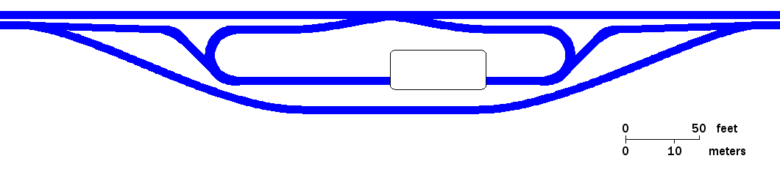
Center Platform Station Geometry Assuming All-Seated Passengers

Slide 14
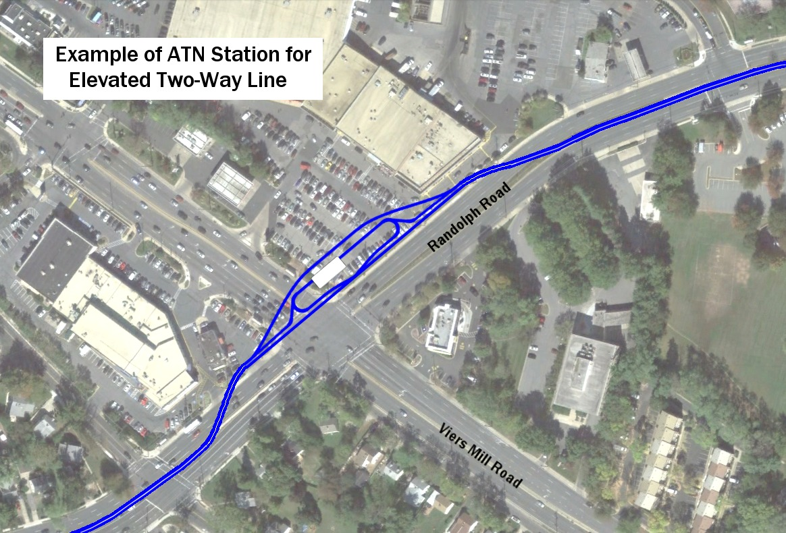

Slide 16
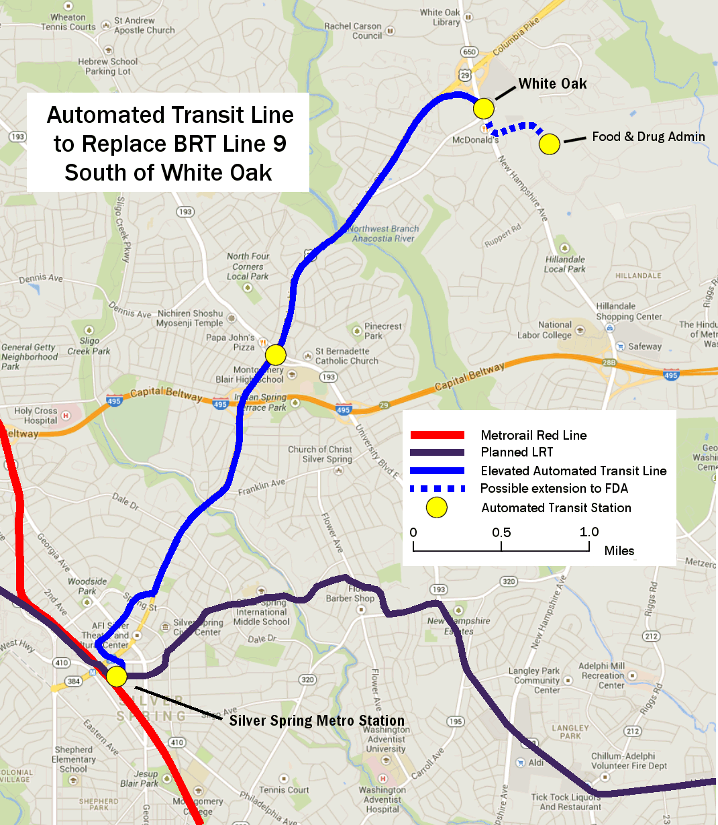

Slide 17
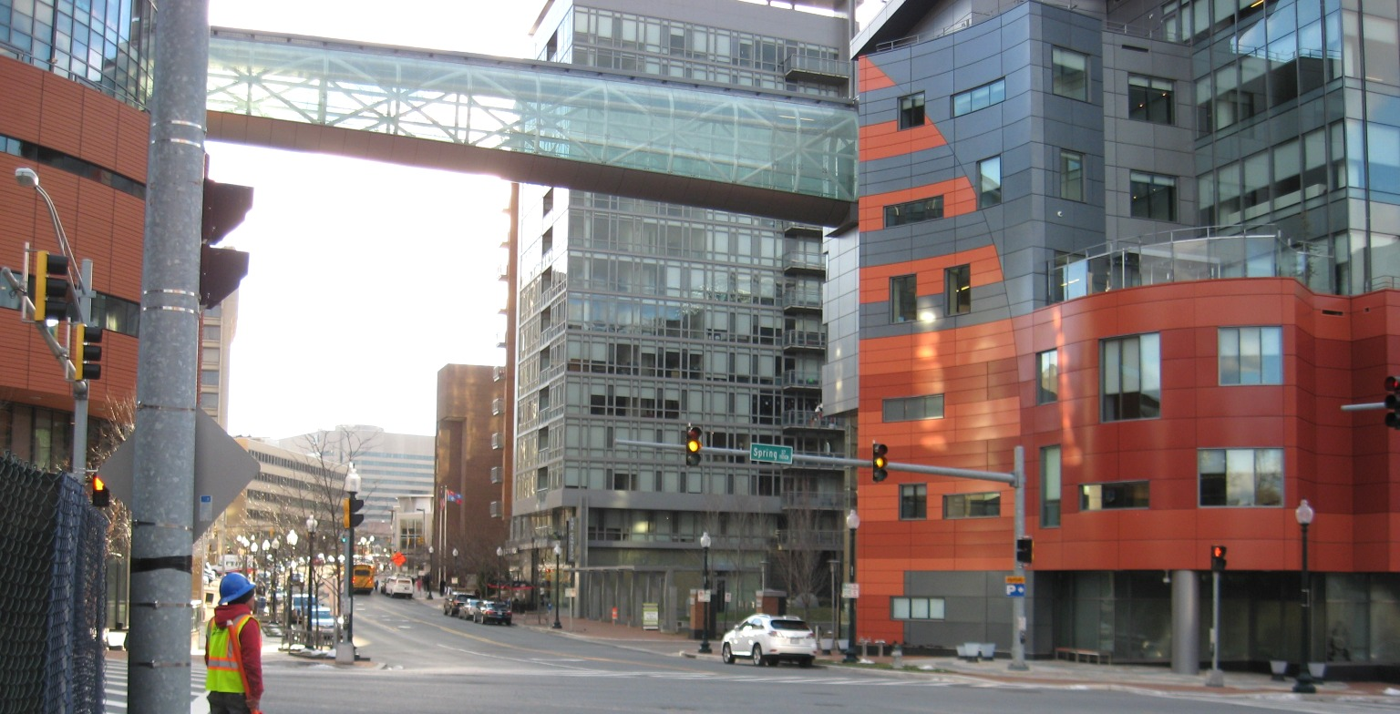
Cameron Street in Silver Spring CBD

Slide 18
Summary of ATN Systems
 | Lane miles* | Stations
Corridor Cities Transitway | 4 | 6
BRT Line 7 (Randolph Rd) | 8 | 5
BRT Line 9 (US 29) | 9 | 3
*Not including on/off ramps, vehicle storage, etc.

